Slide 2
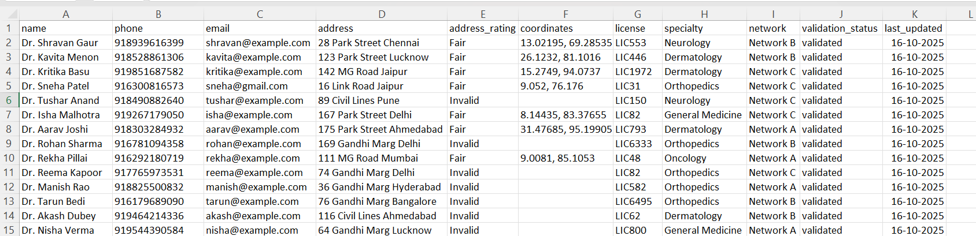
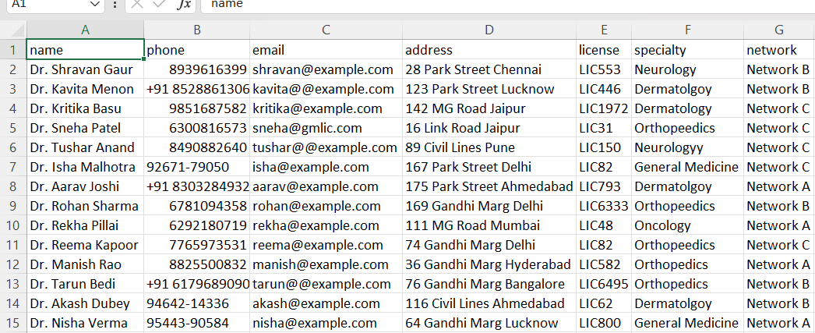
Why Provider Data Validation Matters
Healthcare provider data often contains missing, incomplete, or invalid information such as wrong phone numbers, incorrect addresses, and duplicate entries.
Manual validation of such data is time-consuming, error-prone, and expensive — often taking several days for thousands of records.
Our analysis on the sample healthcare dataset revealed:
• Missing phone numbers and inconsistent email formats
• Invalid or mismatched addresses
• Redundant or incomplete provider details
Automating this process can improve data accuracy by 40–60%, reduce manual effort by 80%, and ensure compliance with healthcare data quality standards.
RAW PROVIDER DATA
CLEANED PROVIDER DATA

Slide 3
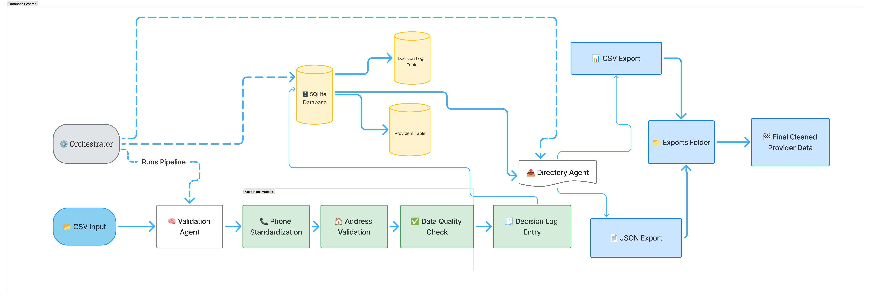
Solution Workflow: Automated Data Cleaning and Validation
The flow begins with raw provider data upload, followed by automatic cleaning and validation by specialized AI agents.
Each correction is logged for transparency, and the final validated data is exported for integration into healthcare systems.

Slide 4
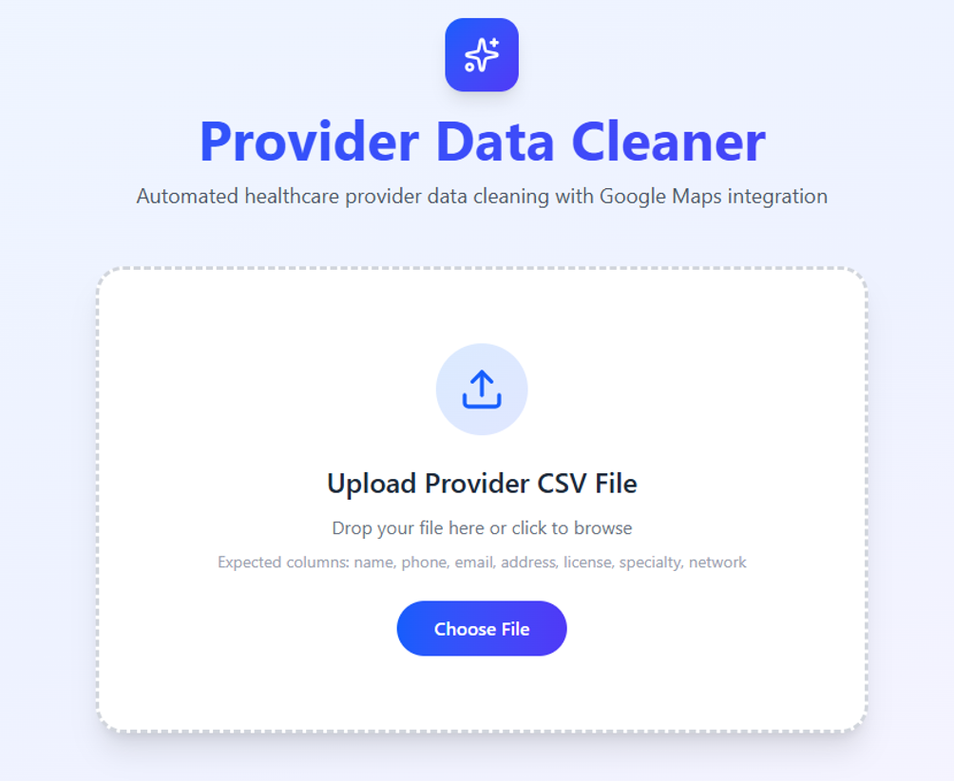
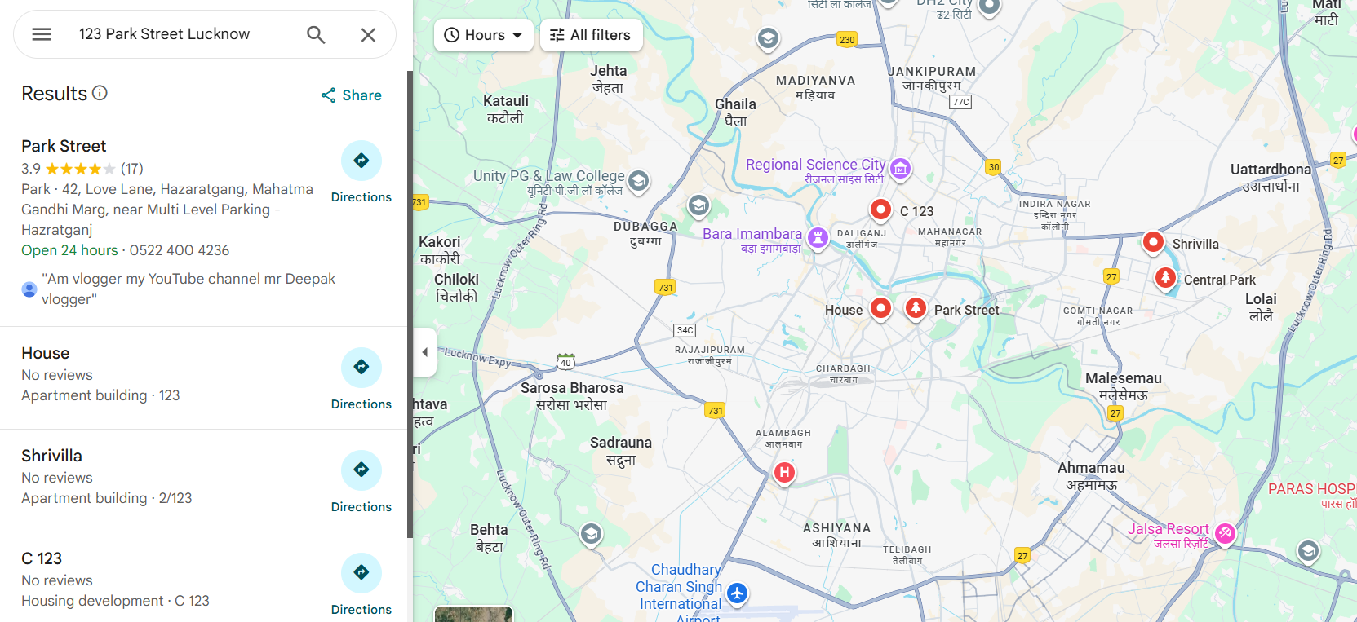
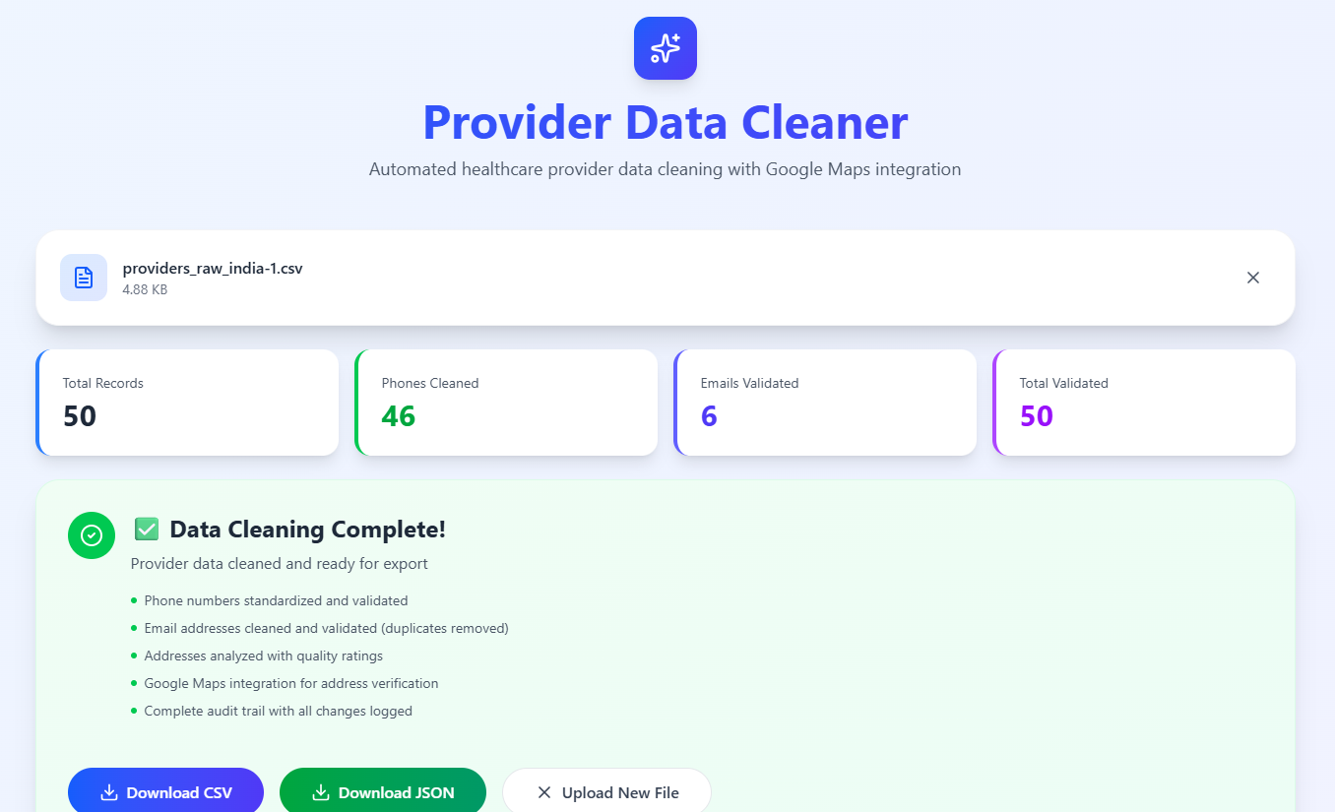
How MediCorrect AI Works
Core Workflow:
1️⃣ Upload Records: User uploads provider data (CSV/Excel)
2️⃣ AI Cleaning: Automatic normalization and formatting
3️⃣ Validation Agents:
• Phone: Validates number format & reachability
• Email: Verifies syntax & domain activity
• Address: Confirms existence via Google Maps API
4️⃣ Quality Check: Flags doubtful or incomplete records
5️⃣ Audit Trail: Logs all corrections and decisions for transparency
Tech Stack: Python | Flask | Pandas | MySQL React | HTML | Tailwind CSS | Google maps API
INPUT
PROCESS
OUTPUT

Slide 5
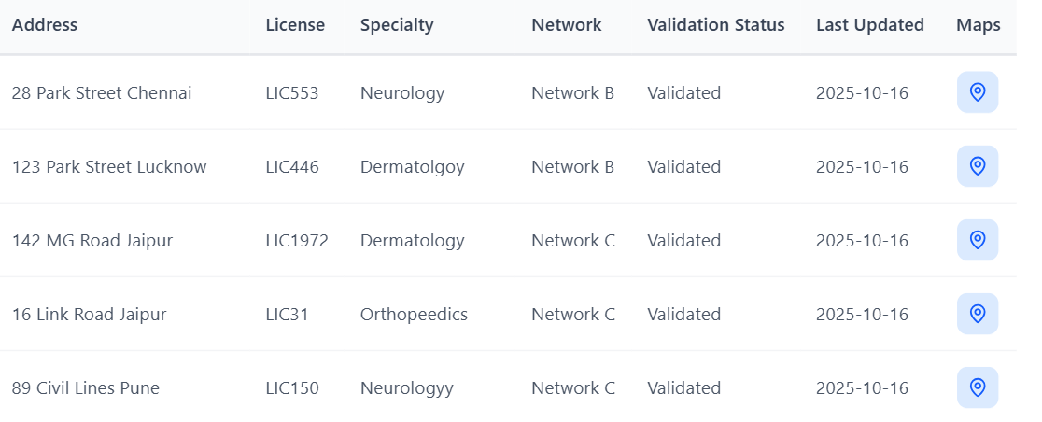

Potential Benefits 💡
Make healthcare directories more accurate | Build trust between patient, doctors because data is reliable.
Reduce manual work | Create a stronger base for future technology
Saves money by lowering wrong claims, waste. | Enhance patient satisfaction
Supports better management of provider networks | Improve coordination and communication across healthcare providers
Future Roadmap:
Phase | Duration | Objective
Phase 1 | 1–2 months | Improve model accuracy & add UI analytics
Phase 2 | 3–5 months | Pilot with local hospitals & health directories
Phase 3 | 6+ months | Nationwide roll-out with regulatory compliance

